Slide 1
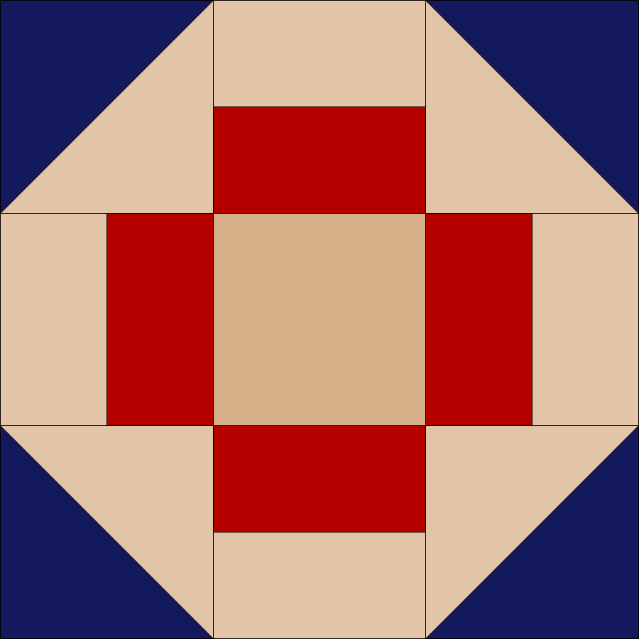
My Family Quilt
Woodson
Penny
Nettie
David
Carissa Gray
Janice
Lucille
Andy
David, Sr.

